Slide 1
Research on ML Algorithms For Face recognition

Slide 2
Algorithms Which are used for Face recognition

Slide 3
Traditional Algorithms
Principal Component Analysis (PCA) – Uses eigenfaces to reduce dimensionality.
Independent Component Analysis (ICA) – Focuses on statistically independent features.
Linear Discriminant Analysis (LDA) – Maximizes class separability.
Elastic Bunch Graph Matching (EBGM) – Uses graph-based representations for face matching.
Viola–Jones Algorithm – Mainly for face detection, using Haar-like features.
Deep Learning-Based Algorithms
Convolutional Neural Networks (CNNs) – Extract hierarchical features for high accuracy.
FaceNet – Maps faces into a Euclidean space for similarity comparison.
DeepFace (by Facebook) – Uses deep learning to classify faces.
DeepID – An earlier deep learning approach to face recognition.
ArcFace – Uses an improved loss function for high-performance facial recognition.

Slide 4
Based on the research the top algorithms are :
Principal Component Analysis (PCA)
Independent Component Analysis (ICA)
Linear Discriminant Analysis (LDA)
Convolutional Neural Networks (CNNs)
FaceNet

Slide 5
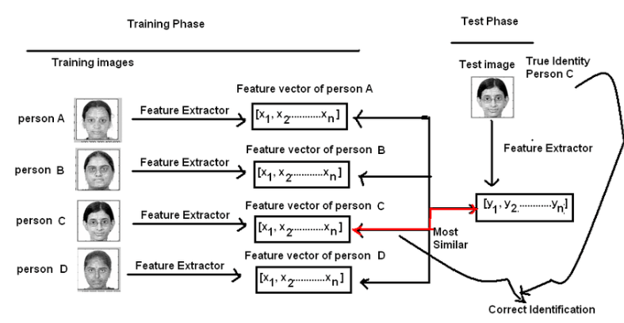
Principal Component Analysis (PCA) for Face Recognition
PCA is a technique used to reduce the dimensionality of data while preserving important information. It is widely used in facial recognition because it allows the system to identify faces efficiently by focusing on key features rather than processing every single pixel in an image.
How PCA Works in Face Recognition (Step by Step)
Image Representation as a Vector (Preprocessing Step)
Mean Face Calculation
Covariance Matrix Computation
Eigenfaces: Finding Principal Components
Feature Extraction: Projecting Faces into the Eigenface Space
Face Recognition: Comparing Feature Vectors

Slide 6
Reaason we use PCA is to solve the problem of overfitting.
PCA just tries to reduce the problem of overfitting
PCA – Converts High dimensions to low dimensions
Image Representation as a Vector (Preprocessing Step):
Every image in a dataset is converted into a numerical format. Computers don't see images as we do; they see them as a grid of numbers (pixel intensity values). For example, if we have a 100x100 grayscale image, it has 10,000 pixels, and it can be represented as a 10,000-dimensional vector.
2. Mean Face Calculation
Once we have all face images converted into vectors, we compute the mean face by averaging all the pixel values of images in the dataset.
Example: If we have 1,000 face images in our dataset, we calculate the average value of each pixel position across all images to form a mean face.
💡 The mean face is used to center the data, meaning we subtract it from each face image to remove unnecessary common features.
Example: A simple 5x5 image represented as numbers:
255 | 200 | 180 | 210 | 190
220 | 180 | 175 | 200 | 170
200 | 160 | 150 | 180 | 160
190 | 140 | 130 | 170 | 150
180 | 130 | 120 | 160 | 140
This is flattened into a single feature vector: 📌 [255, 200, 180, 210, 190, 220, 180, ..., 140]

Slide 7
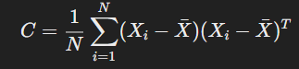
3. Covariance Matrix Computation
Since every face is now represented as a vector, PCA constructs a covariance matrix to find relationships between different pixels.
The covariance matrix captures how pixel values in different images vary together.
It helps in identifying important patterns in the data.
Mathematical formula for covariance matrix:
C= N1​ i=1∑N​ (X i​ − Xˉ )(X i​ − Xˉ ) T
Where:
Xi​ is the face vector.
Xˉbar{X}Xˉ is the mean face.
C is the covariance matrix.
4. Eigenfaces: Finding Principal Components
Eigenfaces are the key component of PCA for face recognition. Eigenfaces are a set of features that best describe the variations in faces.
Steps to Compute Eigenfaces:
Compute the eigenvalues and eigenvectors of the covariance matrix.
Eigenvectors represent principal components, which are directions in which data varies the most.
Eigenfaces are the eigenvectors reshaped into images.
Example of Eigenfaces:
The first few eigenfaces contain the most important features of faces (like eyes, nose, and mouth).

Slide 8
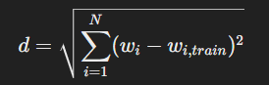
Feature Extraction: Projecting Faces into the Eigenface Space
Each face is now represented as a weighted sum of eigenfaces. Instead of storing the full image, we just store the weights (coefficients) that describe how much each eigenface contributes.
🔹 Formula for Projection:
wi​=uiT​(X−Xˉ)
Where:
𝑋 is the input face image.
𝑋ˉis the mean face.
𝑢𝑖 is the eigenvector (eigenface).
𝑤𝑖 are the weights (feature vector).
6. Face Recognition: Comparing Feature VectorsNow that every face is represented as a feature vector, recognition is simply done by comparing the new face’s feature vector to those stored in the database.🔹 Common Distance Metrics Used:Euclidean Distance: Measures similarity between two feature vectors.Cosine Similarity: Measures the angle between two vectors.
Formula for Euclidean Distance:
The smaller the distance, the more similar the faces are!

Slide 9
PROS and Cons
✅ Reduces Computational Complexity – Instead of comparing full images, we compare smaller feature vectors. ✅ Captures Important Facial Features – Eigenfaces focus on what makes a face unique. ✅ Works Well in Controlled Environments – Good accuracy when lighting and poses are consistent.
🚫 Limitations: ❌ Sensitive to lighting changes and facial expressions. ❌ Doesn't work well with occlusions (partially covered faces).

Slide 10
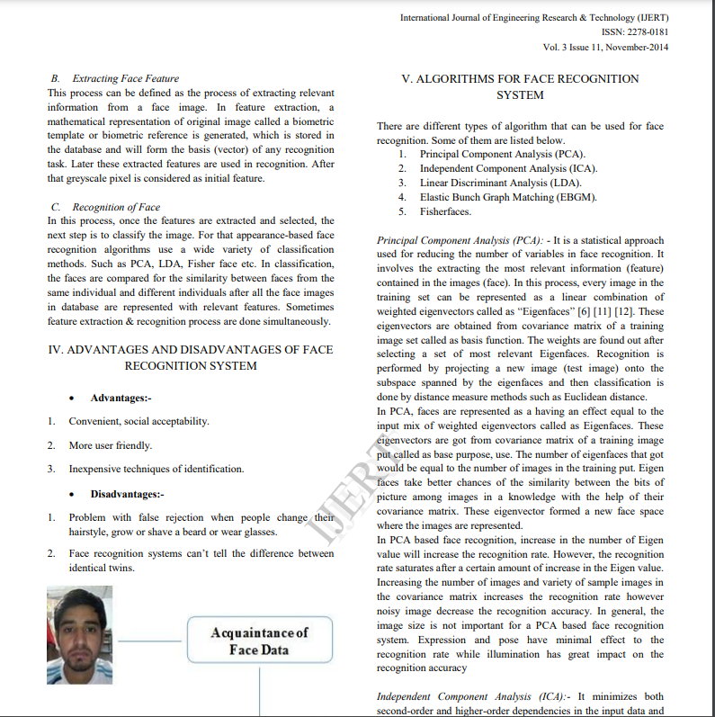
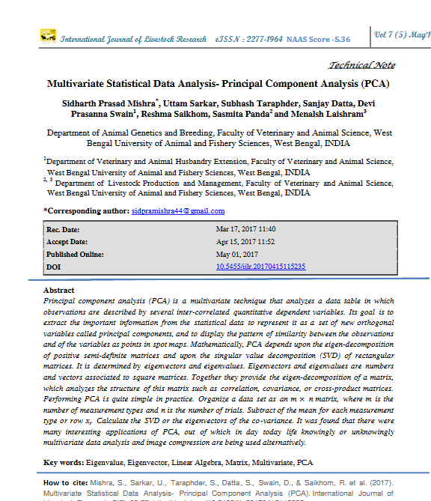










Slide 11
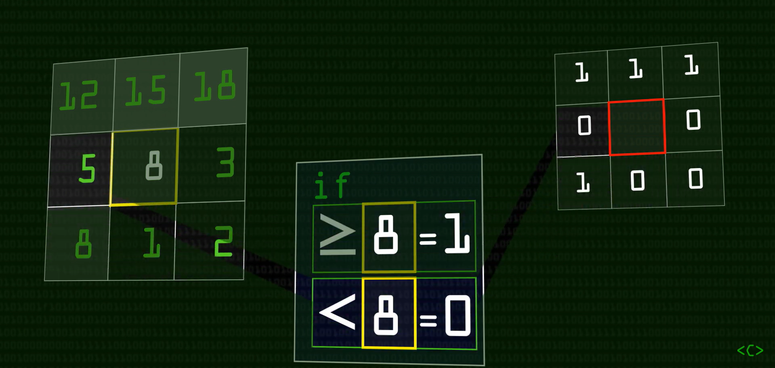
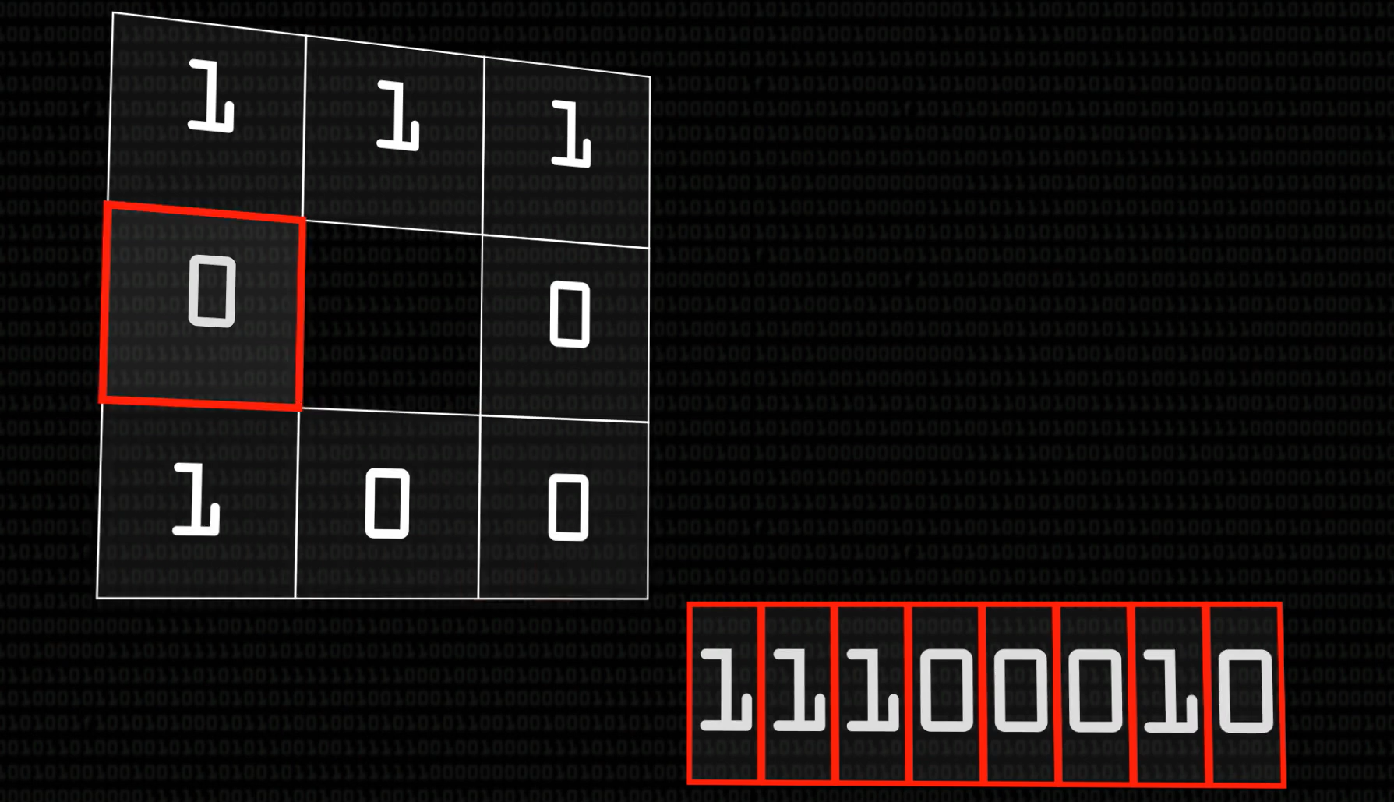
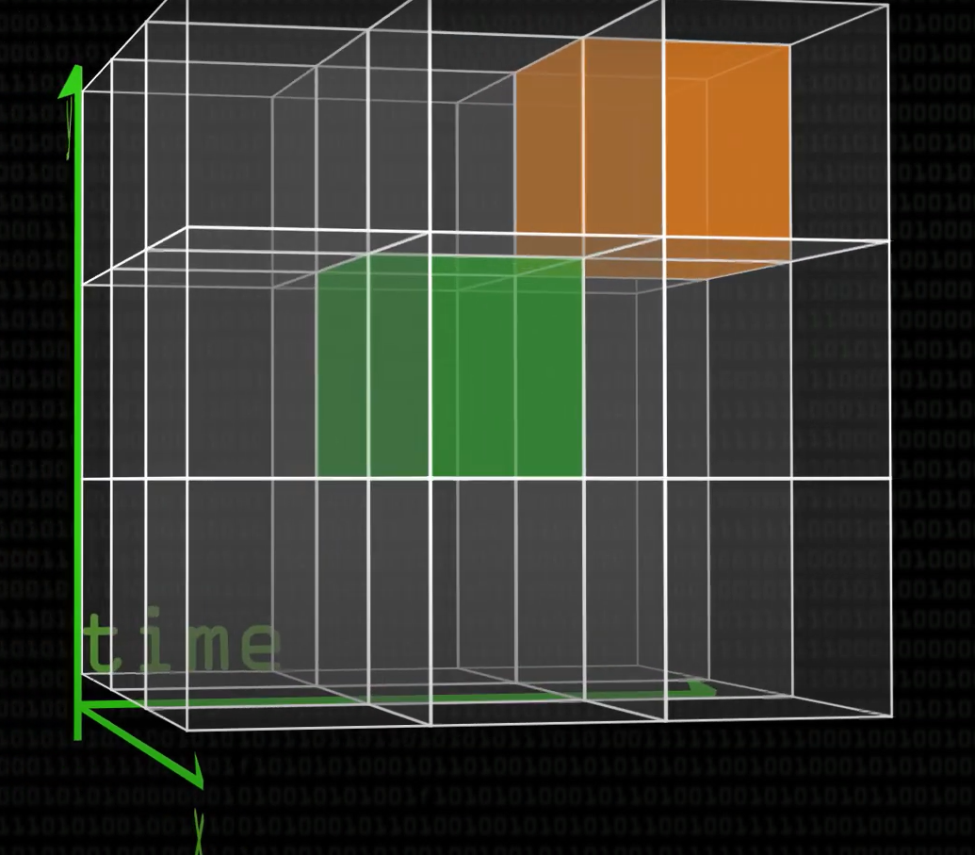
2) Local Binary Patterns Histogram (LBPH)
How LBPH Works (With Images)
Step 1: Convert the Image to Grayscale
Since color information is not needed, we use only grayscale intensity values.
Step 2: Divide the Image into Small Regions
We split the image into small square grids (e.g., 8×8 pixels).
Dividing the Face into a Grid
Step 3: Compute Local Binary Patterns (LBP) for Each Pixel
Each pixel is compared with its 8 neighboring pixels:
If the neighbor is brighter, mark 1
If the neighbor is darker, mark 0
Step 4: Create a Histogram for Each Grid
Each small box (grid) gets a histogram (count of different LBP values).
Step 5: Compare Histograms for Recognition
Each new face compares histograms with stored ones.
✅ Pros: ✔️ Works well even if lighting changes. ✔️ Fast and lightweight (good for real-time).
❌ Cons: 🚫 Struggles with partially hidden faces (glasses, masks).

Slide 12
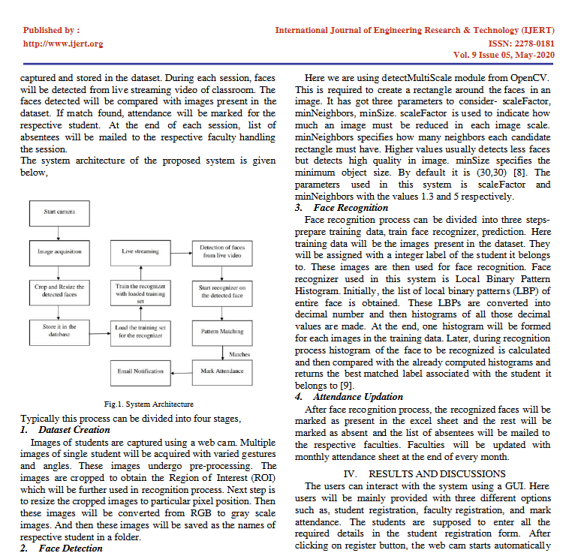
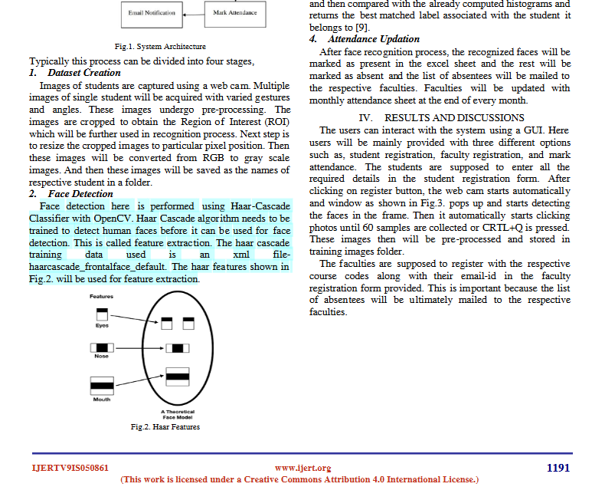






Slide 13
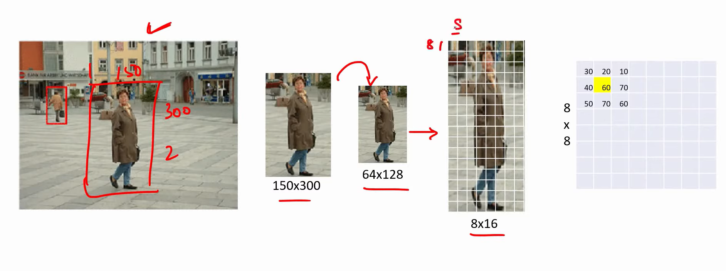
Histogram of Oriented Gradients (HOG) + SVM
How HOG + SVM Works (With Visuals)
Step 1: Convert Image to Grayscale
Removes color, keeping only brightness.
Step 2: Compute Edges Using Gradient Calculation
We look at changes in brightness (edges).
We calculate how light transitions from one pixel to another.
Step 3: Divide Image into Small Cells & Compute HOG Features
The face is divided into small squares (cells).
Each cell stores edge directions in a histogram.

Slide 14
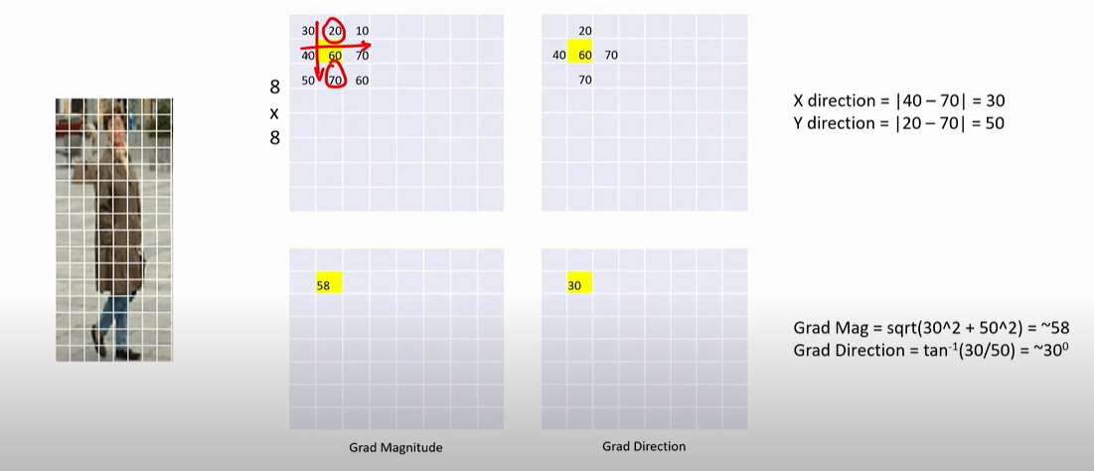
At each pixel:Multiply surrounding pixel values by the kernel values.
Sum the results to get new pixel values.

Slide 15
Step 4: Train SVM (Support Vector Machine) Classifier
The algorithm learns which patterns belong to which person.
Construct HOG Features
The image is divided into small cells (e.g., 8×8 pixels).
Inside each cell:
We compute histograms of gradient directions.
Each direction gets a vote based on its gradient magnitude.
✅ Pros: ✔️ Works well under different lighting. ✔️ More accurate than LBPH.
❌ Cons: 🚫 Not great at recognizing faces with masks/glasses.

Slide 16
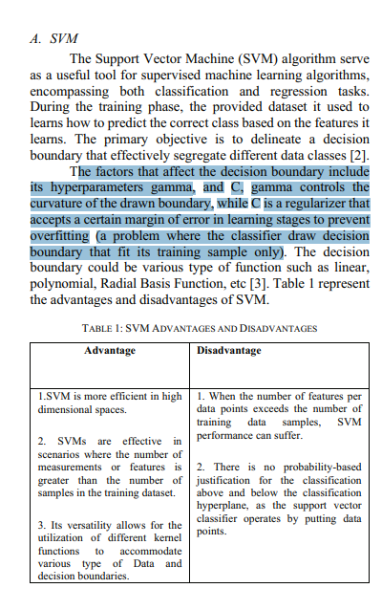
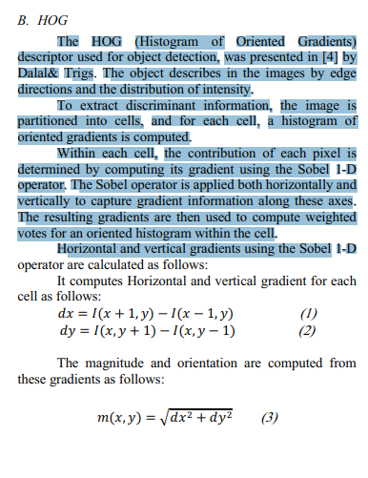
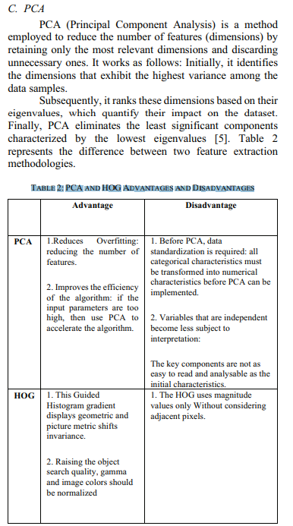

Slide 17
Comparsion of all the researched algorithms
Algorithm | Robust to Lighting? | Handles Occlusions? | Works in Real-Time? | Accuracy
LBPH | ✅ Yes | ❌ No | ✅ Yes | ⭐⭐⭐
HOG + SVM | ✅ Yes | ❌ No | ✅ Yes | ⭐⭐⭐⭐
PCA (Eigenfaces) | ❌ No | ❌ No | ✅ Yes | ⭐⭐
LDA (Fisherfaces) | ✅ Yes | ❌ No | ✅ Yes | ⭐⭐⭐
SIFT | ✅ Yes | ✅ Yes | ❌ No | ⭐⭐⭐⭐⭐

Slide 18
Deep learning algos :
Convolutional Neural Networks (CNNs)

Slide 19
References
https://youtu.be/83x5X66uWK0?si=J2wU8ce1eYzOdoTQ
https://www.researchgate.net/publication/316652806_Principal_Component_Analysis
https://www.ijert.org/research/analysis-of-different-face-recognition-algorithms-IJERTV3IS111235.pdf
https://www.researchgate.net/publication/341876647_Face_Recognition_based_Attendance_Management_System
https://arxiv.org/pdf/1811.00116
https://youtu.be/wpAwdsubl1w?si=xK5NHFlmOywYlp7I
10.1109/CoDIT62066.2024.10708142
10.1109/WiDS-PSU61003.2024.00034
https://youtu.be/28xk5i1_7Zc?si=pPPbJyT2kG0GEtN3

